Slide 1
Introduction to Data Structures

Slide 2

Course Administrivia
My office hours in SAL 210: Mon/Wed 11:40am-1:45pm, Thurs 1:10-2pm.
Exams: two midterms and a final.
You will be allowed a single page of notes.
Six assignments.
Each assignment has a written component, due in one week, and a programming component, due in two weeks.
Lectures will be recorded and posted on the website as soon as they are ready.
Handouts will be posted on the website shortly before start of lecture.
Class should be interactive. Either raise your hand or write in chat to ask questions.

Slide 3
Some Helpful Links
Remedial modules
http://ee.usc.edu/~redekopp/csmodules.html
Class website
http://bytes.usc.edu/cs104/

Slide 4

Organizing Your Data
Should you always sort your data?
No. What are the tradeoffs?
An Insert operation becomes more expensive (but a Lookup operation becomes less expensive)
In a backup system, you are constantly adding new information, and you rarely (hopefully never) look up that information.
How should you organize your data? What is the best data structure?
The answer is, invariably, “it depends.”
Otherwise, this class would be called “Data Structure” (singular), I’d teach it to you today, and everyone would go home and get an A.

Slide 5
Data Structure Consideration
Some questions to consider:
Will you search the data often?
Will data be added in small, frequent chunks?
Will data be added in large, infrequent chunks?
We’ve talked about Insert and Lookup. What other operations are common?
Remove and Update
Which of these operations you need, and how frequently you need each one, will dictate which data structure you select!
There is a data structure called a “Heap” which is really good at all of these operations… except Lookup!
Others, such as AVL Trees, are able to do all 4 operations fairly well (but they are worse than Heaps on every operation except Lookup!)
Yet others, such as Hash Tables, are usually lightning fast, but are probabilistic and occasionally produce very bad runtimes.

Slide 6
Data Structures Matter!
Modern applications process vast amount of data
Various data structures allow these operations to be completed with different time and storage requirements
Data Structure | Insert | Lookup | Get-Min
Unsorted List | Θ(1) | Θ(n) | Θ(n)
AVL Tree | Θ(log n) | Θ(log n) | Θ(log n)
Heap | Θ(log n) | Θ(n) | Θ(1)
Notes:
Chandler's comment: "It's all about data structures"

Slide 7
Importance of Runtime
Problem Size | Bit operations used
n = | log n | n | n log n | n² | 2^{n} | n!
10 | 3 x 10⁻¹¹ s | 10⁻¹⁰ s | 3 x 10⁻¹⁰ s | 10⁻⁹ s | 10⁻⁸ s | 3 x 10⁻⁷ s
10² | 7 x 10⁻¹¹ s | 10⁻⁹ s | 7 x 10⁻⁹ s | 10⁻⁷ s |  | *
10³ | 10⁻¹⁰ s | 10⁻⁸ s | 10⁻⁷ s | 10⁻⁵ s | * | *
10⁴ | 1.3 x 10⁻¹⁰ s | 10⁻⁷ s | 10⁻⁶ s | 10⁻³ s | * | *
10⁵ | 1.7 x 10⁻¹⁰ s | 10⁻⁶ s | 2 x 10⁻⁵ s | 0.1 s | * | *
10⁶ | 2 x 10⁻¹⁰ s | 10⁻⁵ s | 2 x 10⁻⁴ s | 10.2 s | * | *
4 x 10¹¹ years

Slide 8

Abstract Data Types
Programming students tend to focus on the code and less on the data and its organization
More seasoned programmers focus first on
What data they have
How it will be accessed
How it should be organized
An abstract data type describes what data is stored and what operations are to be performed
A data structure is a specific way of storing the data implementing the operations
Example ADT: List
Data: items of the same type in a particular order
Operations: insert, remove, get item at location, set item at location, find
Example data structures implementing a List:
Linked list, array, etc.

Slide 9
Our First ADT
Add(key, value)
The key is how we find the value in the future.
Add(42, Super Mario Bros. 3)
Remove(key)
Remove(1), to remove Minecraft.
Lookup(key)
Lookup(16), to find Pac-Man.
This ADT is known as a map. We implemented the above map using a sorted list. So, is a sorted list a map?
No! The sorted list is the data structure. The map is the ADT.

Slide 10

Course Goals
Learn basic and advanced techniques for implementing data structures and analyzing their efficiency
01
Will require mathematical analysis from CS 170
Learn how to identify the best data structure for your needs.
02
Learn to utilize ADTs to specify the functionality of what you want to do.
03

Slide 11
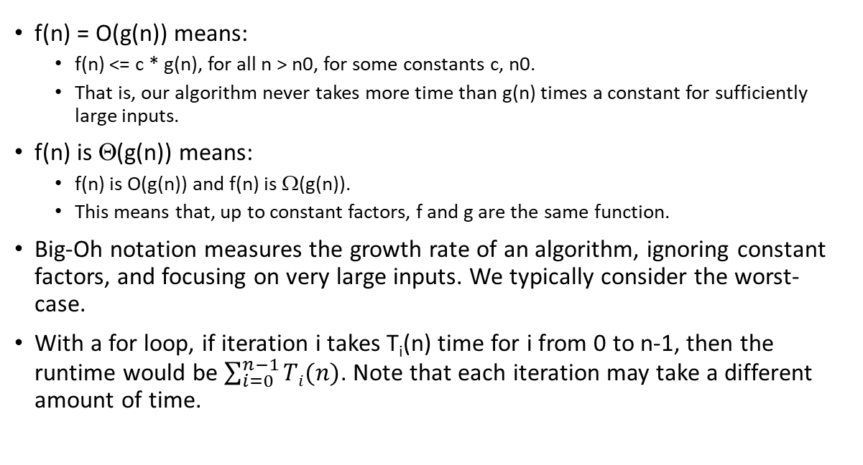
Runtime Review
f(n) = O(g(n)) means:
f(n) <= c * g(n), for all n > n0, for some constants c, n0.
That is, our algorithm never takes more time than g(n) times a constant for sufficiently large inputs.
f(n) is Θ(g(n)) means:
f(n) is O(g(n)) and f(n) is Ω(g(n)).
This means that, up to constant factors, f and g are the same function.
Big-Oh notation measures the growth rate of an algorithm, ignoring constant factors, and focusing on very large inputs. We typically consider the worst-case.
With a for loop, if iteration i takes T_{i}(n) time for i from 0 to n-1, then the runtime would be $\sum_{i=0}^{n−1}{Ti(n)}$. Note that each iteration may take a different amount of time.

Slide 12

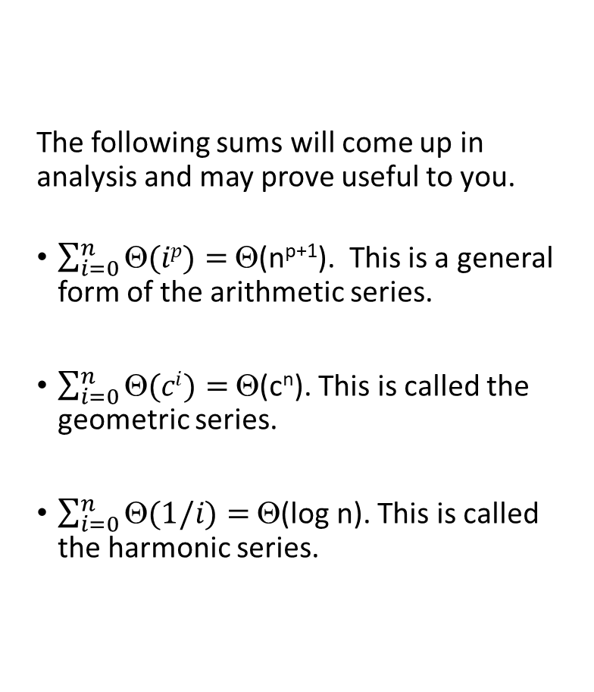
Some Important Summations
The following sums will come up in analysis and may prove useful to you.
$\sum_{i=0}^{n}{Θ(ip)}=$ Θ(n^{p+1}). This is a general form of the arithmetic series.
$\sum_{i=0}^{n}{Θ(ci)}=$ Θ(c^{n}). This is called the geometric series.
$\sum_{i=0}^{n}{Θ(1/i)}=$ Θ(log n). This is called the harmonic series.

Slide 13
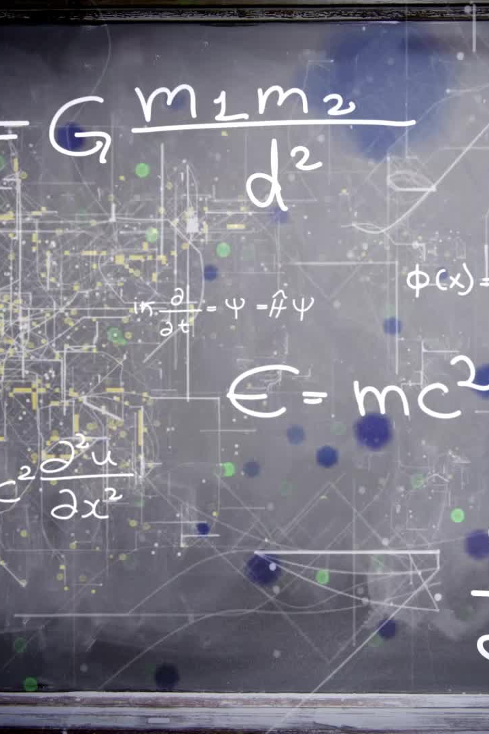
Calculate the Runtime
for (int i = 0; i < n; i++)
if (a[i][0] == 0)
for (int j = 0; j < i; j++)
a[i][j] = i * j ;

Slide 14

Runtime Practice
for (int i = 1; i < n; i *= 2)
for (int j = 0; j < i; j++)
a[i][j] = i * j;

Slide 15
Runtime Practice
for ( int i = 0 ; i < n ; i++)
if ( i == 0)
for ( int j = 0 ; j < n ; j++)
a [ i ] [ j ] = i * j ;

Slide 16
Runtime Practice
int lo = 0 , hi = len-1, mid ;
while ( lo <= hi ) {
mid = ( hi+lo ) / 2 ;
if (b [mid]==t ) return mid ;
else if ( t < b [mid ] ) hi = mid-1;
else lo = mid+1;
}

Slide 17
Runtime Practice
for ( int i = 0 ; i < n ; i++)
if ( ( i % 2) == 0)
for ( int j = 0 ; j < n ; j++)
a [ i ] [ j ] = i * j ;
else
a [ i ] [ 0 ] = i ;

Slide 18
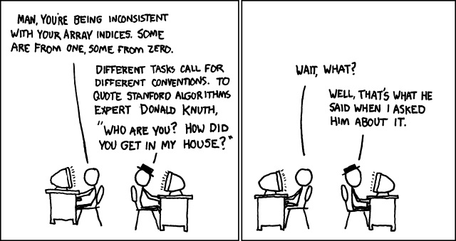
Runtime Practice
for ( int i = 1 ; i < n ; i++)
for ( int j = 0 ; j < n ; j += i )
a [ i ] [ j ] = i * j ;
XKCD #163

Slide 19
Runtime Practice
for ( int i = 0 ; i < n ; i++)
for ( int j = i ; j < n ; j++)
for ( int k = i ; k < j ; k++)
a [ i ] [ j ] [ k ] = i * j *k ;

